Slide 1
CS 7900 Information Security
Firewalls and Intrusion Dection Systems
This lecture slide is mainly based on the power point slides by Professor Mark Stamp.
CS7900, Meilin Liu
Notes:
Zili Shao

Slide 2



Firewalls
Internal
network
Internet
Firewall
Firewall decides what to let in to internal network and/or what to let out
Access control for the network
CS7900, Meilin Liu

Slide 3
Firewall as Secretary
A firewall is like a secretary
To meet with an executive
  First contact the secretary
  Secretary decides if meeting is important
  So, secretary filters out many requests
You want to meet chair of CS department?
  Secretary does some filtering
You want to meet the POTUS?
  Secretary does lots of filtering
CS7900, Meilin Liu

Slide 4
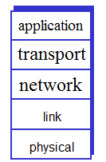
TCP/IP
Physical layer
Link layer
Network layer
Transport layer
Application layer
CS7900, Meilin Liu

Slide 5
Firewall Terminology
No standard firewall terminology
Types of firewalls
  Packet filter ⎯ works at network layer
  Stateful packet filter ⎯ transport layer
  Application proxy ⎯ application layer
Other terms often used
  E.g., “deep packet inspection”
CS7900, Meilin Liu

Slide 6
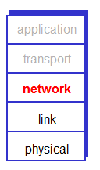
Packet Filter
Operates at network layer
Can filters based on…
  Source IP address
  Destination IP address
  Source Port
  Destination Port
  Flag bits (SYN, ACK, etc.)
  Egress or ingress
CS7900, Meilin Liu

Slide 7
Packet Filter
Advantages?
  Speed
Disadvantages?
  No concept of state
  Cannot see TCP connections
  Blind to application data
CS7900, Meilin Liu

Slide 8
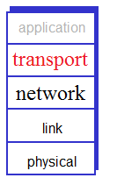
Stateful Packet Filter
Adds state to packet filter
Operates at transport layer
Remembers TCP connections, flag bits, etc.
Can even remember UDP packets (e.g., DNS requests)
CS7900, Meilin Liu

Slide 9
Stateful Packet Filter
Advantages?
  Can do everything a packet filter can do plus...
  Keep track of ongoing connections (so prevents TCP ACK scan)
Disadvantages?
  Cannot see application data
  Slower than packet filtering
CS7900, Meilin Liu

Slide 10
Packet Filtering Examples
Block all packets with IP protocol field = 17 and with either source or destination port = 23.
  All incoming and outgoing UDP flows blocked
  All Telnet connections are blocked
Block inbound TCP packets with SYN but no ACK
  Prevents external clients from making TCP connections with internal clients
  But allows internal clients to connect to outside
Block all packets with TCP port of IRC
CS7900, Meilin Liu

Slide 11
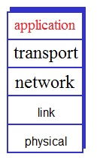
Application Proxy
A proxy is something that acts on your behalf
Application proxy looks at incoming application data
Verifies that data is safe before letting it in
CS7900, Meilin Liu

Slide 12
Application-level Firewall
Example: allow select internal users to IRC outside.
  Parse the IRC protocol and get the username
  Match the username with the whitelist
Example: block user access to know porn websites
  Parse HTML, Check if the Web URL is in a “black-list”
Example: block emails whose attachments contain
sensitive information
  Parse MIME, Encoding, Zip archives
  Perform keyword checking
CS7900, Meilin Liu

Slide 13
Application Proxy
Advantages?
  Complete view of connections and applications data
  Filter bad data at application layer (viruses, Word macros)
Disadvantages?
  Speed
CS7900, Meilin Liu

Slide 14
Application Proxy
Creates a new packet before sending it through to internal network
Attacker must talk to proxy and convince it to forward message
Proxy has complete view of connection
Prevents some scans stateful packet filter cannot
CS7900, Meilin Liu

Slide 15
Intrusion Prevention
Want to keep bad guys out
Intrusion prevention is a traditional focus of computer security
  Authentication is to prevent intrusions
  Firewalls a form of intrusion prevention
  Virus defenses aimed at intrusion prevention
  Like locking the door on your car
CS7900, Meilin Liu

Slide 16
Types of Intrusion Detection System
An Intrusion Prevention System (IPS) is software with all the properties of IDS, with the additional feature that it stops the intrusions.
An Intrusion Detection System (IDS) is software that automates the intrusion detection process.
CS7900, Meilin Liu

Slide 17
Intrusion Detection
In spite of intrusion prevention, bad guys will sometime get in
Intrusion detection systems (IDS)
  Detect attacks in progress (or soon after)
  Look for unusual or suspicious activity
IDS evolved from log file analysis
IDS is currently a hot research topic
How to respond when intrusion detected?
  We don’t deal with this topic here…
CS7900, Meilin Liu

Slide 18
Examples of Intrusion
remote root compromise
web server defacement
guessing / cracking passwords
copying databases containing credit card numbers
viewing sensitive data without authorization
running a packet sniffer
distributing pirated software
using an unsecured modem to access internal network
impersonating an executive to get information
using an unattended workstation
CS7900, Meilin Liu
Notes:
[GRAN04] lists the following examples of intrusion:
• Performing a remote root compromise of an e-mail server
• Defacing a Web server
• Guessing and cracking passwords
• Copying a database containing credit card numbers
• Viewing sensitive data, including payroll records and medical information,
without authorization
• Running a packet sniffer on a workstation to capture usernames and passwords
• Using a permission error on an anonymous FTP server to distribute pirated
software and music files
• Dialing into an unsecured modem and gaining internal network access
• Posing as an executive, calling the help desk, resetting the executive’s e-mail
password, and learning the new password
• Using an unattended, logged-in workstation without permission

Slide 19
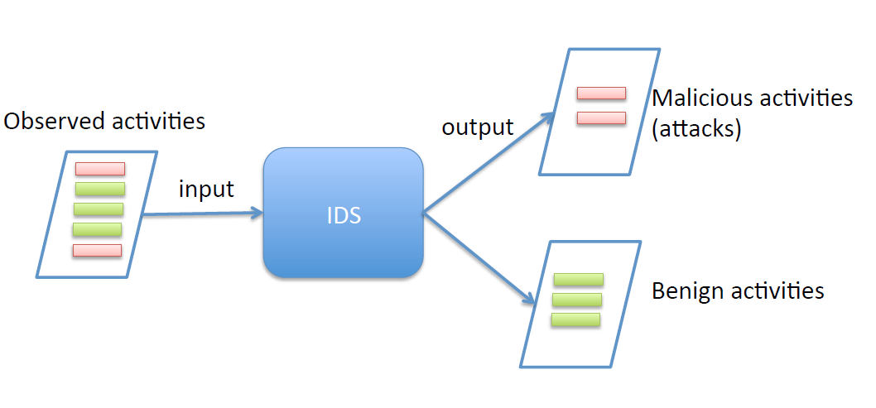
High Level View of IDS
CS7900, Meilin Liu

Slide 20
Intrusion Detection Systems
Who is likely intruder?
  May be outsider who got thru firewall
  May be evil insider
What do intruders do?
  Launch well-known attacks
  Launch variations on well-known attacks
  Launch new/little-known attacks
  “Borrow” system resources
  Use compromised system to attack others. etc.
CS7900, Meilin Liu

Slide 21
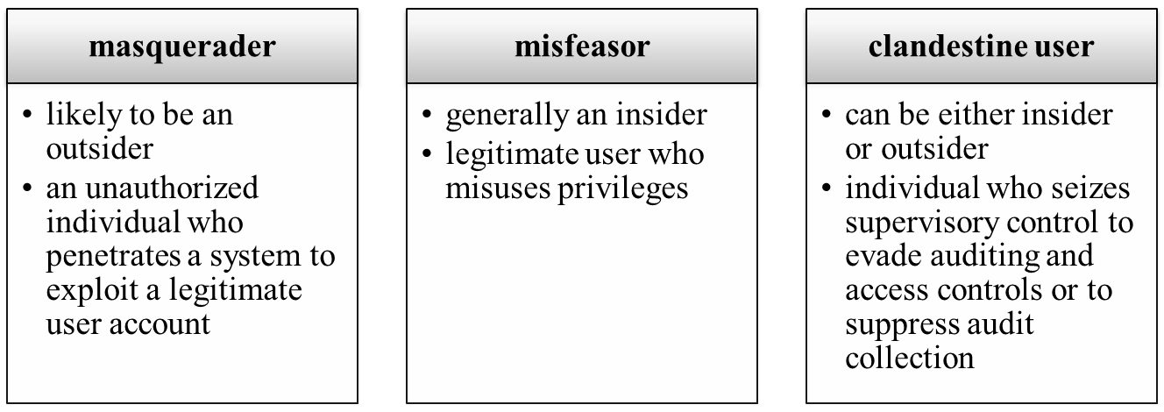
Intruders
  two most publicized threats to security are malware and intruders.
  intruders generally referred to as a hacker or cracker
classes:
CS7900, Meilin Liu
Notes:
One of the two most publicized threats to security is the intruder (the other is
malware), generally referred to as a hacker or cracker. In an important early study
of intrusion, Anderson [ANDE80] identified three classes of intruders:
• Masquerader: An individual who is not authorized to use the computer
and who penetrates a system’s access controls to exploit a legitimate user’s
account
• Misfeasor: A legitimate user who accesses data, programs, or resources for
which such access is not authorized, or who is authorized for such access but
misuses his or her privileges
• Clandestine user: An individual who seizes supervisory control of the system
and uses this control to evade auditing and access controls or to suppress audit
collection
The masquerader is likely to be an outsider; the misfeasor generally is an insider;
and the clandestine user can be either an outsider or an insider.
Intruder attacks range from the benign to the serious. At the benign end of the
scale, there are many people who simply wish to explore internets and see what is
out there. At the serious end are individuals who are attempting to read privileged
data, perform unauthorized modifications to data, or disrupt the system.

Slide 22
Hackers
motivated by thrill of access and/or status
  hacking community is a strong meritocracy
  status is determined by level of competence
benign intruders consume resources and slow performance for legitimate users
intrusion detection systems (IDSs) and intrusion prevention systems (IPSs) are designed to help counter hacker threats
  can restrict remote logons to specific IP addresses
  can use virtual private network technology (VPN)
intruder problem led to establishment of computer emergency response teams (CERTs)
CS7900, Meilin Liu
Notes:
Traditionally, those who hack into computers do so for the thrill of
it or for status. The hacking community is a strong meritocracy in which status
is determined by level of competence. Thus, attackers often look for targets of
opportunity and then share the information with others. A typical example is a
break-in at a large financial institution reported in [RADC04]. The intruder took
advantage of the fact that the corporate network was running unprotected services,
some of which were not even needed. In this case, the key to the break-in was the
pcAnywhere application. The manufacturer, Symantec, advertises this program as
a remote control solution that enables secure connection to remote devices. But the
attacker had an easy time gaining access to pcAnywhere; the administrator used the
same three-letter username and password for the program. In this case, there was
no intrusion detection system on the 700-node corporate network. The intruder was
only discovered when a vice president walked into her office and saw the cursor
moving files around on her Windows workstation.
Benign intruders might be tolerable, although they do consume resources and
may slow performance for legitimate users. However, there is no way in advance to
know whether an intruder will be benign or malign. Consequently, even for systems
with no particularly sensitive resources, there is a motivation to control this problem.
Intrusion detection systems (IDSs) and intrusion prevention systems (IPSs),
of the type described in this chapter and Chapter 9 , respectively, are designed to
counter this type of hacker threat. In addition to using such systems, organizations
can consider restricting remote logons to specific IP addresses and/or use virtual
private network technology.
One of the results of the growing awareness of the intruder problem has been
the establishment of a number of computer emergency response teams (CERTs).
These cooperative ventures collect information about system vulnerabilities and disseminate
it to systems managers. Hackers also routinely read CERT reports. Thus,
it is important for system administrators to quickly install all software patches to
discovered vulnerabilities. Unfortunately, given the complexity of many IT systems,
and the rate at which patches are released, this is increasingly difficult to achieve
without automated updating. Even then, there are problems caused by incompatibilities
resulting from the updated software. Hence the need for multiple layers of
defense in managing security threats to IT systems.

Slide 23
Criminals
organized groups of hackers now a threat
  corporation / government / loosely affiliated gangs
  typically young
  often Eastern European, Russian, or southeast Asian hackers
  meet in underground forums
  common target is credit card files on e-commerce servers
criminal hackers usually have specific targets
  once penetrated act quickly and get out
IDS / IPS can be used but less effective
sensitive data should be encrypted
CS7900, Meilin Liu
Notes:
Organized groups of hackers have become a widespread and common
threat to Internet-based systems. These groups can be in the employ of a corporation
or government but often are loosely affiliated gangs of hackers. Typically, these
gangs are young, often Eastern European, Russian, or southeast Asian hackers who
do business on the Web [ANTE06]. They meet in underground forums with names
like DarkMarket.org and theftservices.com to trade tips and data and coordinate
attacks. A common target is a credit card file at an e-commerce server. Attackers
attempt to gain root access. The card numbers are used by organized crime gangs
to purchase expensive items and are then posted to carder sites, where others can
access and use the account numbers; this obscures usage patterns and complicates
investigation.
Whereas traditional hackers look for targets of opportunity, criminal hackers
usually have specific targets, or at least classes of targets in mind. Once a site is
penetrated, the attacker acts quickly, scooping up as much valuable information as
possible and exiting.
IDSs and IPSs can also be used for these types of attackers but may be less
effective because of the quick in-and-out nature of the attack. For e-commerce sites,
database encryption should be used for sensitive customer information, especially
credit cards. For hosted e-commerce sites (provided by an outsider service), the
e-commerce organization should make use of a dedicated server (not used to support
multiple customers) and closely monitor the provider’s security services.

Slide 24
Insider Attacks
among most difficult to detect and prevent
employees have access and systems knowledge
may be motivated by revenge/entitlement
  employment was terminated
  taking customer data when moving to a competitor
IDS / IPS can be useful but also need:
  enforcement of least privilege, monitor logs, strong authentication, termination process
CS7900, Meilin Liu
Notes:
Insider attacks are among the most difficult to detect and
prevent. Employees already have access and knowledge about the structure and
content of corporate databases. Insider attacks can be motivated by revenge of
simply a feeling of entitlement. An example of the former is the case of Kenneth
Patterson, fired from his position as data communications manager for American
Eagle Outfitters. Patterson disabled the company’s ability to process credit
card purchases during five days of the holiday season of 2002. As for a sense of
entitlement, there have always been many employees who felt entitled to take
extra office supplies for home use, but this now extends to corporate data. An
example is that of a vice president of sales for a stock analysis firm who quit to go
to a competitor. Before she left, she copied the customer database to take with her.
The offender reported feeling no animus toward her former employee; she simply
wanted the data because it would be useful to her.
Although IDS and IPS facilities can be useful in countering insider attacks, other
more direct approaches are of higher priority. Examples include the following:
• Enforce least privilege, only allowing access to the resources employees need
to do their job.
• Set logs to see what users access and what commands they are entering.
• Protect sensitive resources with strong authentication.
• Upon termination, delete employee’s computer and network access.
• Upon termination, make a mirror image of employee’s hard drive before
reissuing it. That evidence might be needed if your company information turns
up at a competitor.

Slide 25
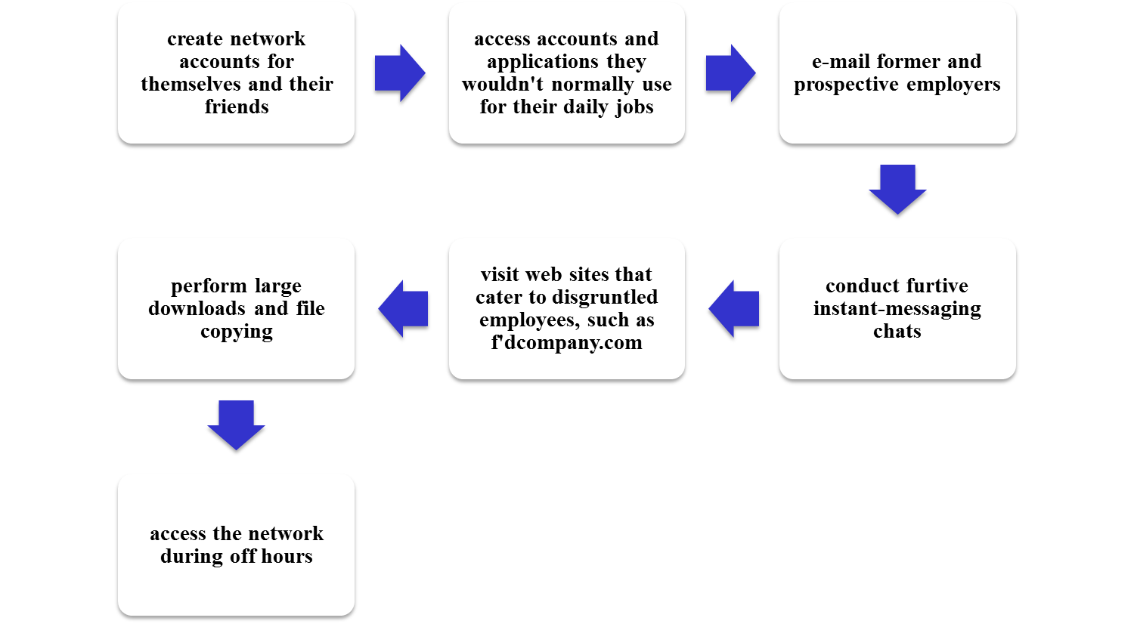
Internal Threat
Patterns of Behavior
CS7900, Meilin Liu
Notes:
Table 8.1(c)
Insider Attack Patterns of Behavior

Slide 26
The following definitions from RFC 2828
(Internet Security Glossary)
are relevant to our discussion:
Security Intrusion: A security event, or a combination of multiple security events, that constitutes a security incident in which an intruder gains, or attempts to gain, access to a system (or system resource) without having authorization to do so.
Intrusion Detection: A security service that monitors and analyzes system events for the purpose of finding, and providing real-time or near real-time warning of, attempts to access system resources in an unauthorized manner.
CS7900, Meilin Liu
Notes:
The objective of the intruder is to gain access to a system or to increase the range
of privileges accessible on a system. Most initial attacks use system or software
vulnerabilities that allow a user to execute code that opens a back door into the
system. Intruders can get access to a system by exploiting attacks such as buffer
overflows on a program that runs with certain privileges. We examine such software
vulnerabilities in Part Two.
Alternatively, the intruder attempts to acquire information that should have
been protected. In some cases, this information is in the form of a user password.
With knowledge of some other user’s password, an intruder can log in to a system
and exercise all the privileges accorded to the legitimate user. Password guessing
and password acquisition techniques are discussed in Chapter 3 .
The following definitions from RFC 2828 (Internet Security Glossary) are relevant
to our discussion:
Security Intrusion: A security event, or a combination of multiple security
events, that constitutes a security incident in which an intruder gains, or attempts
to gain, access to a system (or system resource) without having authorization
to do so.
Intrusion Detection : A security service that monitors and analyzes
system events for the purpose of finding, and providing real-time or near
real-time warning of, attempts to access system resources in an unauthorized
manner.

Slide 27
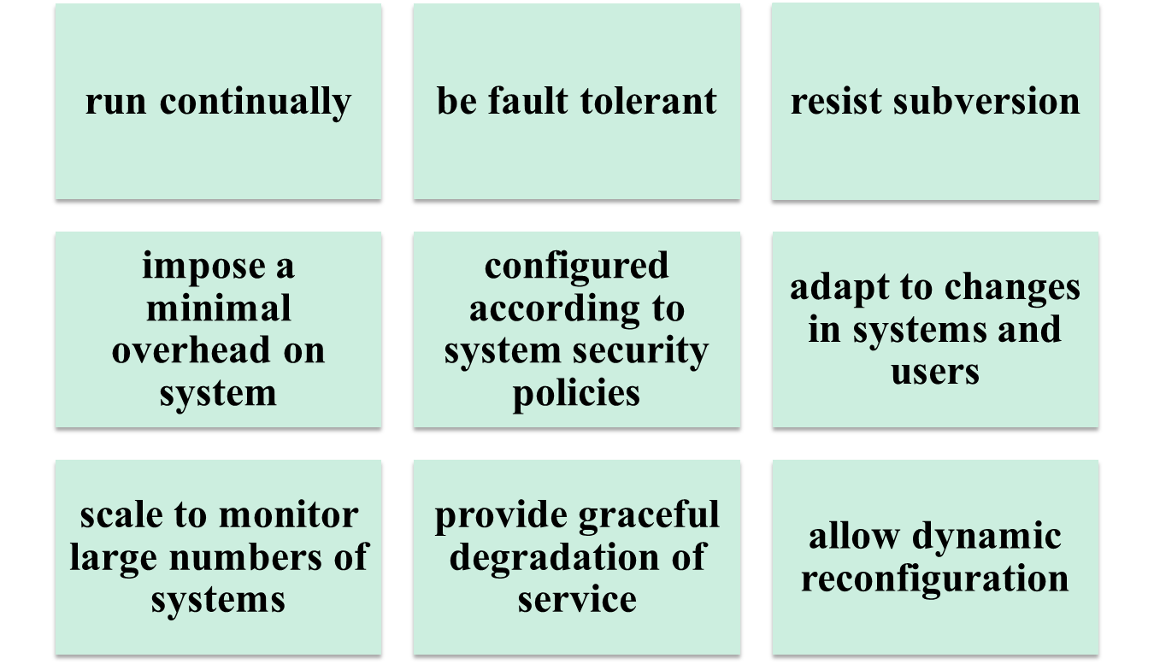
IDS Requirements
CS7900, Meilin Liu
Notes:
[BALA98] lists the following as desirable for an IDS. It must
• Run continually with minimal human supervision.
• Be fault tolerant in the sense that it must be able to recover from system
crashes and reinitializations.
• Resist subversion. The IDS must be able to monitor itself and detect if it has
been modified by an attacker.
• Impose a minimal overhead on the system where it is running.
• Be able to be configured according to the security policies of the system that is
being monitored.
• Be able to adapt to changes in system and user behavior over time.
• Be able to scale to monitor a large number of hosts.
• Provide graceful degradation of service in the sense that if some components
of the IDS stop working for any reason, the rest of them should be affected as
little as possible.
• Allow dynamic reconfiguration; that is, the ability to reconfigure the IDS
without having to restart it.

Slide 28
High Level View of IDS
CS7900, Meilin Liu

Slide 29
False Positives and False Negatives
  Intrusion Detection System cannot make complete and accurate detection, so there are false positives and false negatives.
  False Positive: When the IDS incorrectly identifies a benign (harmless) activity to be malicious, a false positive is said to have occurred.
  False Negative: When the IDS fails to identify a malicious activity, a false negative is said to have occurred.
CS7900, Meilin Liu

Slide 30
Elements of An Intrusion Detection System
Primary assumptions:
  System activities are observable
  Normal and intrusive activities are distinct evidence
Components of intrusion detection systems:
  From an algorithmic perspective
    Features -- capture intrusion evidences
    Models -- piece evidences together
  From a system architecture perspective:
    Data collection, data processor, decision engine, alarm generation and responses….
CS7900, Meilin Liu

Slide 31
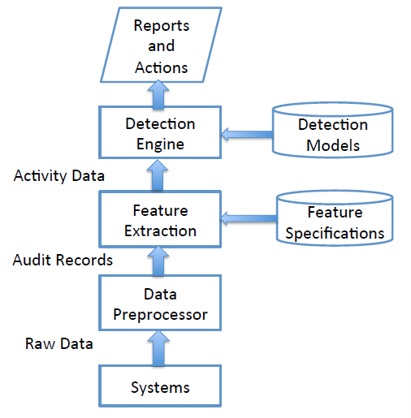
Components of An Intrusion Detection System
CS7900, Meilin Liu

Slide 32
IDS
Intrusion detection approaches
  Signature-based IDS
    Detect attacks based on specific known signatures or patterns
  Anomaly-based IDS
    Attempt to define a baseline of normal behavior and provide a warning whenever the system strays too far from this baseline
Intrusion detection architectures
  Host-based IDS
  Network-based IDS
Any IDS can be classified as above
CS7900, Meilin Liu

Slide 33
Intrusion Detection Systems (IDSs)
  host-based IDS: monitors the characteristics of a single host for suspicious activity
  network-based IDS: monitors network traffic and analyzes network, transport, and application protocols to identify suspicious activity
CS7900, Meilin Liu
Notes:
IDSs can be classified as follows:
• Host-based IDS : Monitors the characteristics of a single host and the events
occurring within that host for suspicious activity
• Network-based IDS : Monitors network traffic for particular network segments
or devices and analyzes network, transport, and application protocols
to identify suspicious activity
An IDS comprises three logical components:
• Sensors: Sensors are responsible for collecting data. The input for a sensor
may be any part of a system that could contain evidence of an intrusion. Types
of input to a sensor includes network packets, log files, and system call traces.
Sensors collect and forward this information to the analyzer.
• Analyzers: Analyzers receive input from one or more sensors or from other
analyzers. The analyzer is responsible for determining if an intrusion has
occurred. The output of this component is an indication that an intrusion has
occurred. The output may include evidence supporting the conclusion that an
intrusion occurred. The analyzer may provide guidance about what actions to
take as a result of the intrusion.
• User interface: The user interface to an IDS enables a user to view output
from the system or control the behavior of the system. In some systems, the
user interface may equate to a manager, director, or console component.

Slide 34
Host-Based IDS
Monitor activities on hosts for
  Known attacks
  Suspicious behavior
Designed to detect attacks such as
  Buffer overflow
  Escalation of privilege, …
Little or no view of network activities
CS7900, Meilin Liu

Slide 35
Network-Based IDS
Monitor activity on the network for…
  Known attacks
  Suspicious network activity
Designed to detect attacks such as
  Denial of service
  Network probes
  Malformed packets, etc.
Some overlap with firewall
Little or no view of host-base attacks
Can have both host and network IDS
CS7900, Meilin Liu

Slide 36
Key Metrics of IDS
Effectiveness
  High detection rates
  low false positive rates
Efficiency
  NIDS: the throughput of NIDS, the scalability?
  HIDS: the impact on the system performance?
Resilience to attacks
  IDS can be the target of attackers
CS7900, Meilin Liu

Slide 37
Signature-based Detection
A signature is a pattern that corresponds to a known threat
Signature based detection is the process of comparing the signature, which identifies a know threat against the events that are observed
Example:
  A telnet attempt with root as the username
  An email with subject name “Free xyz” or an attachment, “picture.jpg”
  If N or more failed login attempts in M seconds, IDS warns of attack
CS7900, Meilin Liu

Slide 38
Signature-based Detection
Failed login attempts may indicate password cracking attack
IDS could use the rule “N failed login attempts in M seconds” as signature
If N or more failed login attempts in M seconds, IDS warns of attack
Note that such a warning is specific
  Admin knows what attack is suspected
  Easy to verify attack (or false alarm)
CS7900, Meilin Liu

Slide 39
Signature Detection
Suppose IDS warns whenever N or more failed logins in M seconds
  Set N and M so false alarms not common
  Can do this based on “normal” behavior
But, if Trudy knows the signature, she can try N − 1 logins every M seconds…
Then signature detection slows down Trudy, but might not stop her
CS7900, Meilin Liu

Slide 40
Signature Detection
Many techniques used to make signature detection more robust
Goal is to detect “almost” signatures
For example, if “about” N login attempts in “about” M seconds
  Warn of possible password cracking attempt
  What are reasonable values for “about”?
  Can use statistical analysis, heuristics, etc.
  Must not increase false alarm rate too much
CS7900, Meilin Liu

Slide 41
Signature Detection
Advantages of signature detection
  Simple
  Detect known attacks
  Know which attack at time of detection
  Efficient (if reasonable number of signatures)
Disadvantages of signature detection
  Signature files must be kept up to date
  Number of signatures may become large
  Can only detect known attacks
  Variation on known attack may not be detected
CS7900, Meilin Liu

Slide 42
Anomaly-based Detection
Anomaly based detection is the process of comparing definitions of activities which are supposed to be normal against observed events to identify deviations, to look for unusual or abnormal behavior
An IDS which uses anomaly based detection techniques has profiles that represent the normal behavior of users, hosts, network connections, or applications.
  For example, a normal profile could include the fact that web activity is the most commonly done activity during day hours
The major benefit of anomaly detection is that they can be very effective in detecting previously unknown threats.
CS7900, Meilin Liu

Slide 43
Anomaly-based Detection
Anomaly detection systems look for unusual or abnormal behavior
  For example, the power consumption of a computer may increase drastically compared to normal characteristic due to an infection from a malware.
There are (at least) two challenges
  What is normal for this system?
  How “far” from normal is abnormal?
No avoiding statistics here!
  mean defines normal
  variance gives distance from normal to abnormal
CS7900, Meilin Liu

Slide 44
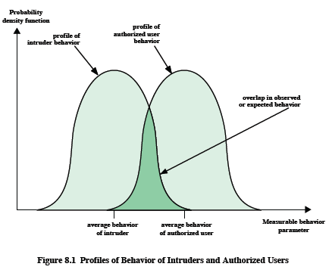
IDS Principles
  assume intruder behavior differs from legitimate users
  overlap in behaviors causes problems
  false positives
  false negatives
CS7900, Meilin Liu

Slide 45

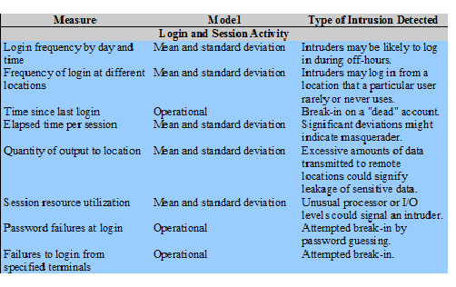
Measures That May Be Used for Intrusion Detection
CS7900, Meilin Liu

Slide 46
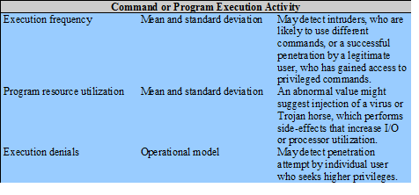
Measures That May Be Used for Intrusion Detection
CS7900, Meilin Liu

Slide 47
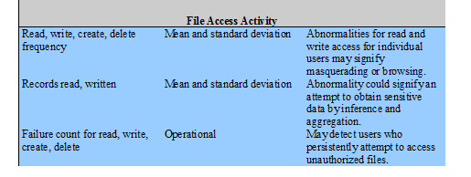
Measures That May Be Used for Intrusion Detection
CS7900, Meilin Liu

Slide 48
Anomaly-based Detection
Advantages?
  Chance of detecting unknown attacks
Disadvantages?
  Cannot use anomaly detection alone…
  …must be used with signature detection
  Reliability is unclear
  May be subject to attack
  Anomaly detection indicates “something unusual”, but lacks specific info on possible attack
CS7900, Meilin Liu

Slide 49
Anomaly Detection: The Bottom Line
Anomaly-based IDS is active research topic
Many security experts have high hopes for its ultimate success
Often cited as key future security technology
Hackers are not convinced!
  Title of a talk at Defcon: “Why Anomaly-based IDS is an Attacker’s Best Friend”
Anomaly detection is difficult and tricky
As hard as AI?
CS7900, Meilin Liu

